Slide 1

NFT Tickets Technical Presentation
EVENT TICKET
BAMDE / LEMAIRE / PASSO-KAFACK / POPILLE / PRIEUR

Slide 2
Objectives
Creating immutable, unique and interactive NFT Tickets which would be scanned to gain access to various events
Creating personalized tickets by adding original and rare contents. Such as AI created image or buying a dedicated moment of the event making them collectable.
Limiting possible abuses of misappropriation of event tickets such as black marketing & fake identification.
Keeping better record of attendance by utilizing the blockchain as a ledger.
.

Slide 3
Table of contents
01
02
03
VISUAL OF THE TICKET
TECHNOLOGY USED FOR TICKET CREATION
TECHNOLOGY USED FOR NFT

Slide 4
01
VISUAL OF THE TICKET

Slide 5
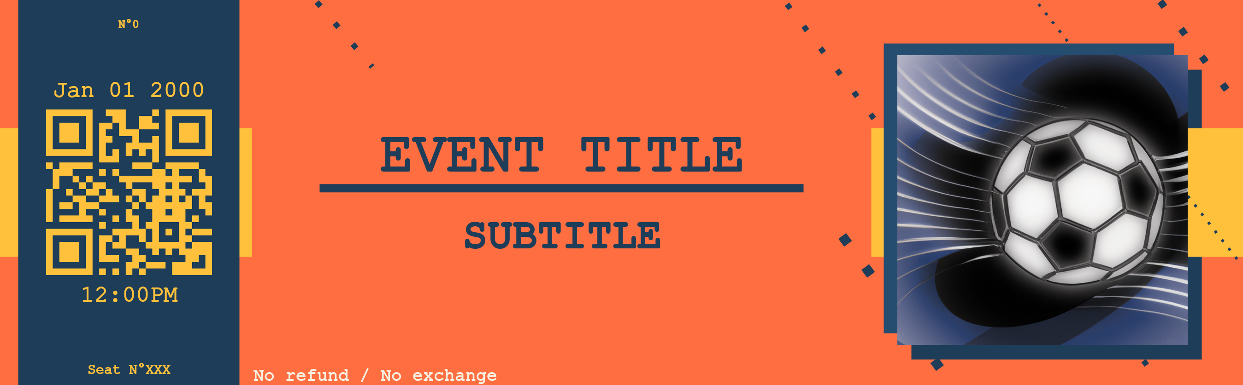



Template the ticket
Ticket Number
Date
Title
QR Code
with url
Hour
Seat
Subtitle
Personalized picture related to the event
Colors :
(255, 193, 59)
(30, 61, 89)
(255, 193, 59)

Slide 6
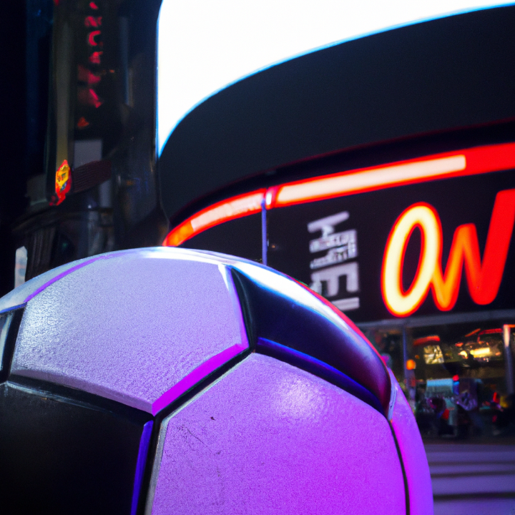


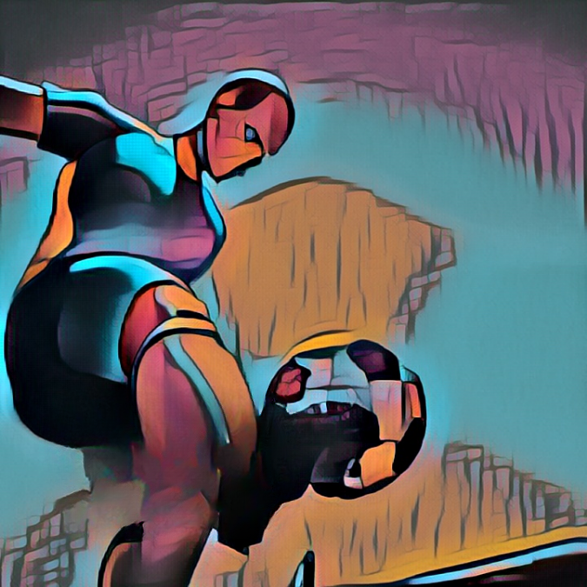
Visual of the ticket
Each picture is generated by DALL·E, a deep learning model.
It means that they are all unique and related to the event.
DALL·E website : https://labs.openai.com/

Slide 7
02
TECHNOLOGY USED FOR TICKET CREATION

Slide 8



Technology used
DALL-E
LANGUAGES USED
LIBRARIES USED
AI system that can create realistic images and art from a description in natural language
QRcode
requests

Slide 9
Ticket generation
Creates a ticket through a Python package
Package inputs are :
About the ticket : ID, URL of the QR code, collector picture, price and wallet id
About the event : Title, subtitle, date, seat, location
The QR code is then automatically generated
The date is processed
The generated picture is resized

Slide 10
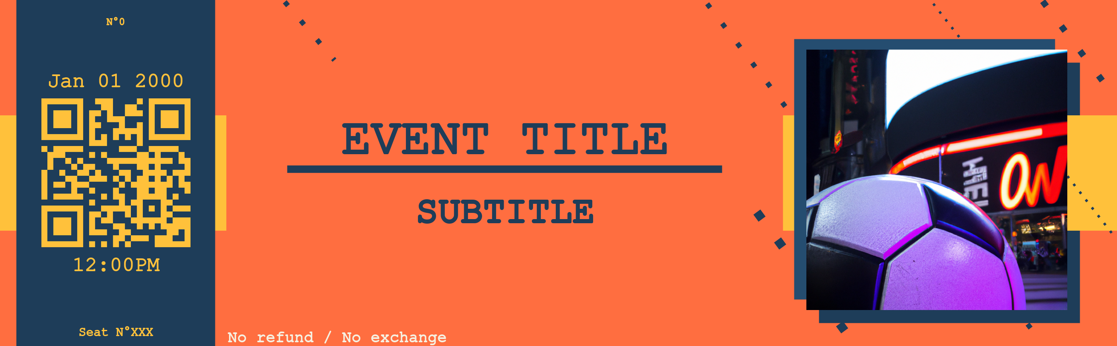
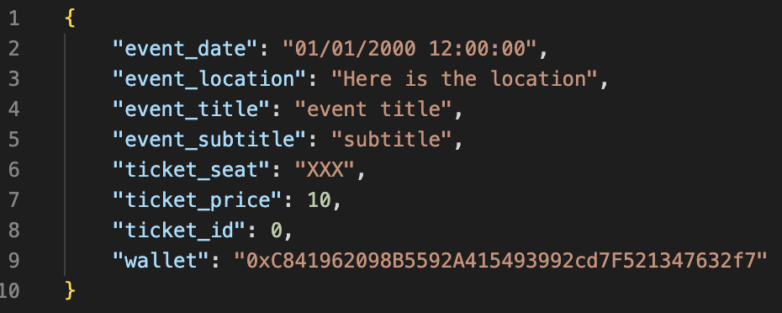
Technology used
The package outputs are:
A picture : The ticket in PNG format
A JSON : Information related to the ticket used for NFT minting
As a temporary solution, we store them locally. The final aim would be to fully automatize the process

Slide 11
03
TECHNOLOGY USED FOR NFT

Slide 12
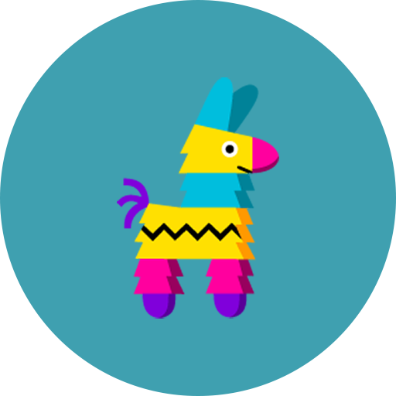


Technology used
PINATA
METAMASK
ALCHEMY
Provide a key vault, secure login, token wallet, and token exchange to manage the digital assets
A powerful blockchain developer platform providing a suite of developer tools
NFT distribution platform empowering creators, developers and marketplaces to store, manage and monetize their content across any blockchain

Slide 13
NFT Creation & Minting
Creates an NFT and mint it using the NFT package with npm
Package inputs are :
A Mumbai valid wallet private key (using Metamask in our case)
An account on Pinata to host our ticket PNG and JSON file
Deploy your smart contract on the Mumbai network using your Metamask wallet
Run the Mint function after uploading your metadata & image on Pinata
Check your NFT creation on OPENSEA

Slide 14
03
IDEAS FOR THE FUTURE

Slide 15
For the future
Use the QR-code to identify the information related to the ticket generated
Automatize the creation of the unique image related to the event (DALL E)
Make a link between our package and the NFT generator ensuring that the whole process is fully automated from the creation of the ticket to its minting
Make an app where customers will be able to generate events and make a reservation (Front-end & Back-end)

Slide 16
Thanks for your attention!
Do you have any questions?
BAMDE / LEMAIRE / PASSO-KAFACK / POPILLE / PRIEUR

